Slide 1
WEB & Mobile Application development
Module – 01
CSS Class 05
Saylani Mass IT Training Faisalabad
Instructor : Umair Azmat
WhatsApp : +923217061116

Slide 2
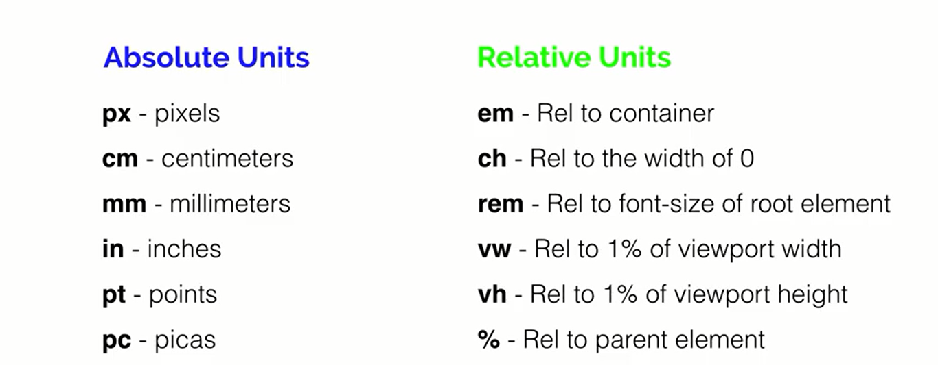
CSS Numerical Units

Slide 3
Text Formatting
Text-align
Text decoration (line , style , color)
Text-indent (only for 1st line)
Text-transform
Text-shadow
Word spacing
Letter spacing

Slide 4
Fonts
Font Size
Font weight
Font Family
By adding <link>
By Importing in css @import
Downloading and adding @ font-face

Slide 5
CSS Colors
Color Name
Hex #6 digits (red , green , blue)
Rgb rgb (red , green , blue)
Rgba rgba (red , green, blue ,opacity)
Hsl hsl(hue, saturation%, lightness%)
Hsla hsla(hue, saturation%, lightness% , opacity)

Slide 6
CSS Backgrounds
Background-Color
Background-Image
Background-Repeat
Background-Size
Background-Position
Short-Hand Property url position/size repeats

Slide 7
CSS Gradient Backgrounds
Linear Gradient :
To create a linear gradient you must define at least two color stops.
background-image: linear-gradient(to right, red , yellow);
background-image: linear-gradient (direction, color-stop1, color-stop2, ...);
Angle
To right , to left , to top , to bottom
Repeating linear gradient

Slide 8
Radial Gradient
A radial gradient is defined by its center.
background-image: radial-gradient(closest-side at 60% 55%, red, yellow, black);
background-image: radial-gradient(shape size at position, start-color, ..., last-color);
closest-side
farthest-side
closest-corner
farthest-corner

Slide 9
Conic Gradients
A conic gradient is a gradient with color transitions rotated around a center point.
background-image: conic-gradient(from 90deg, red, yellow, green);
background-image: conic-gradient([from angle] [at position,] color [degree], color [degree], ...);
background-image: repeating-conic-gradient(red 10%, yellow 20%);
repeating-conic-gradient
At position

Slide 10
The position Property
The position property in CSS tells about the method of positioning for an element or an HTML entity. There are five different types of position property available in CSS:
Static
Fixed
Relative
Absolute
Sticky

Slide 11
CSS Positioning Elements
The positioning of an element can be done using the top, right, bottom, and left properties.
These specify the distance of an HTML element from the edge of the viewport.
To set the position by these four properties, we have to declare the positioning method.
They also work differently depending on the position value.

Slide 12
Static
Every element has a static position by default, so the element will stick to the normal page flow.
So if there is a left/right/top/bottom/z-index set then there will be no effect on that element.
This method of positioning is set by default.
If we don’t mention the method of positioning for any element, the element has the position: static method by default.

Slide 13
Relative
An element with its position set to relative and when is adjusted using top , bottom ,left, right will be positioned relative to its original position.
Setting the top, right, bottom, and left properties of a relatively-positioned element will cause it to be adjusted away from its normal position.
Other content will not be adjusted to fit into any gap left by the element.

Slide 14
Absolute
When you take an element out of the normal flow by using position: absolute, it will look for an ancestor element that has its own position set.
An element with position: absolute; is positioned relative to the nearest positioned ancestor (instead of positioned relative to the viewport, like fixed).
This is so the child knows what element it should position itself in relation to.
However; if an absolute positioned element has no positioned ancestors, it uses the document body, and moves along with page scrolling.

Slide 15
Fixed
Any HTML element with position: fixed will take the element out of the normal flow
An element with fixed positioning allows it to remain at the same position even we scroll the page.
We can set the position of the element using the top, right, bottom, left.
scrolling will not affect its position at all.

Slide 16
Sticky
Position: sticky elements will initially behave like position: relative elements,
but if you keep scrolling, they will get taken out of the normal flow and behave like position: fixed wherever you have positioned them.

